Slide 1
Ethernet Frames, Ethernet and the OSI Model, Ethernet Frame Fields, Ethernet MAC Address, Frame Processing
Lecture 10-11 (Theory)
Dr. Yogesh
Department of Computer Science and Engineering,
Chitkara University, Punjab
Computer Networks _22CS008

Slide 2
Index
Ethernet Frames
Ethernet and the OSI Model
Ethernet Frame Fields
Ethernet MAC Address
Frame Processing

Slide 3
Ethernet Frames
The two most prominent LAN technologies in use today are Ethernet and WLAN.
Ethernet supports bandwidths of up to 100 Gbps, which explains its popularity.
Ethernet is one of two LAN technologies used today, with the other being wireless LANs (WLANs).
Ethernet uses wired communications, including twisted pair, fiber-optic links, and coaxial cables.

Slide 4
Ethernet Frames
Ethernet operates in the data link layer and the physical layer. It is a family of networking technologies defined in the IEEE 802.2 and 802.3 standards.
Ethernet supports data bandwidths of the following:
10 Mbps
100 Mbps
1000 Mbps (1 Gbps)
10,000 Mbps (10 Gbps)
40,000 Mbps (40 Gbps)
100,000 Mbps (100 Gbps)

Slide 5
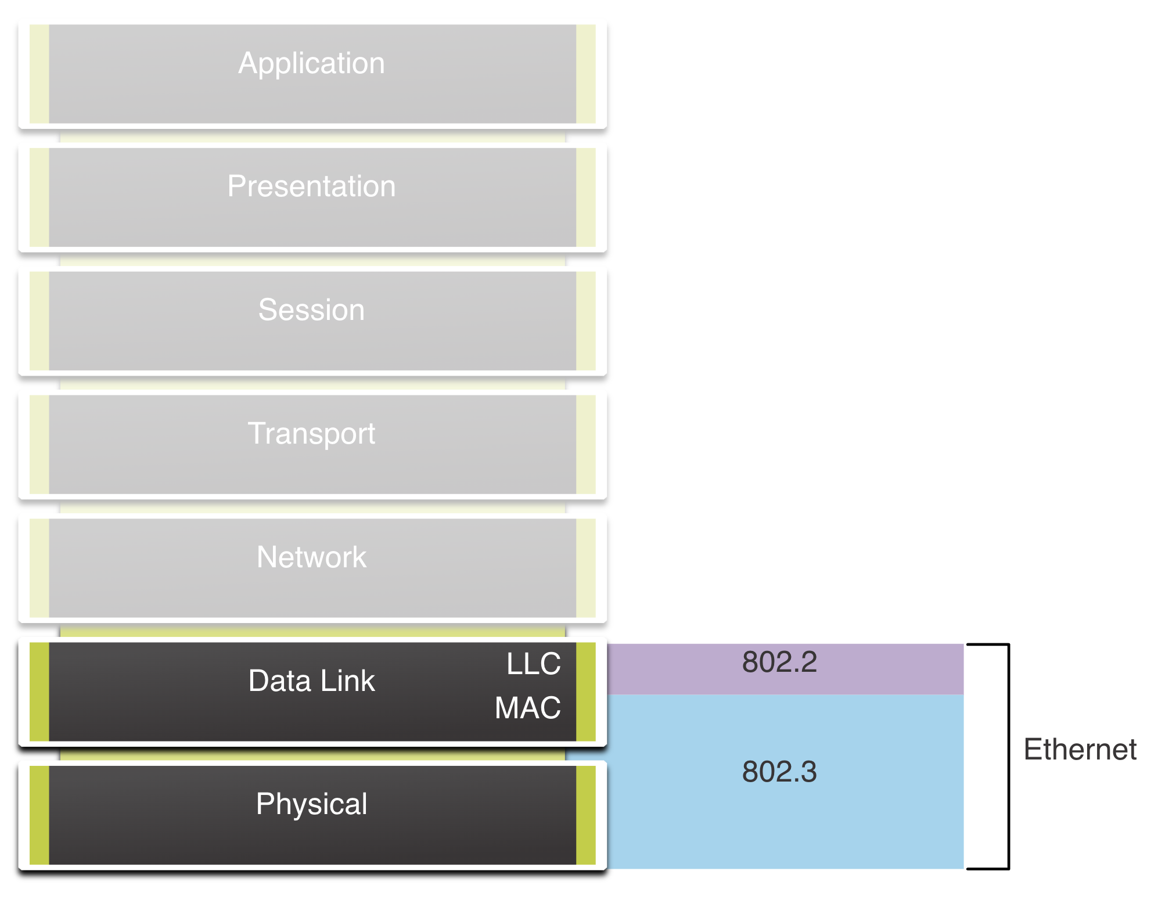
Ethernet and the OSI Model
Fig. 1 Ethernet and the OSI Model

Slide 6
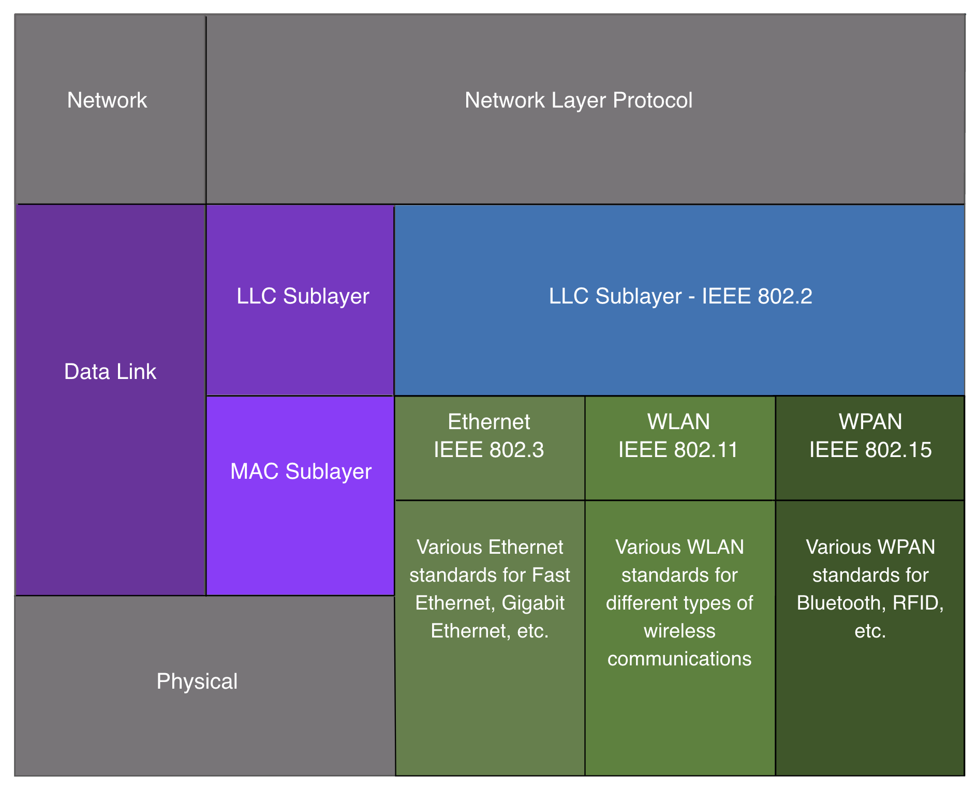
Data Link Sublayers
IEEE 802 LAN/MAN protocols, including Ethernet, use the following two separate sublayers of the data link layer to operate.
They are the Logical Link Control (LLC) and the Media Access Control (MAC), as shown in the figure.
Fig. 2 Data link layer

Slide 7
LLC Sublayer
This IEEE 802.2 sublayer communicates between the networking software at the upper layers and the device hardware at the lower layers.
It places information in the frame that identifies which network layer protocol is being used for the frame.
This information allows multiple Layer 3 protocols, such as IPv4 and IPv6, to use the same network interface and media.

Slide 8
MAC Sublayer
This sublayer (IEEE 802.3, 802.11, or 802.15 for example) is implemented in hardware and is responsible for data encapsulation and media access control.
It provides data link layer addressing and is integrated with various physical layer technologies.

Slide 9
MAC Sublayer
The MAC sublayer is responsible for data encapsulation and accessing the media.
Data Encapsulation
IEEE 802.3 data encapsulation includes the following:
Ethernet frame - This is the internal structure of the Ethernet frame.
Ethernet Addressing - The Ethernet frame includes both a source and destination MAC address to deliver the Ethernet frame from Ethernet NIC to Ethernet NIC on the same LAN.
Ethernet Error detection - The Ethernet frame includes a frame check sequence (FCS) trailer used for error detection.
Accessing the Media
The IEEE 802.3 MAC sublayer includes the specifications for different Ethernet communications standards over various types of media including copper and fiber.

Slide 10
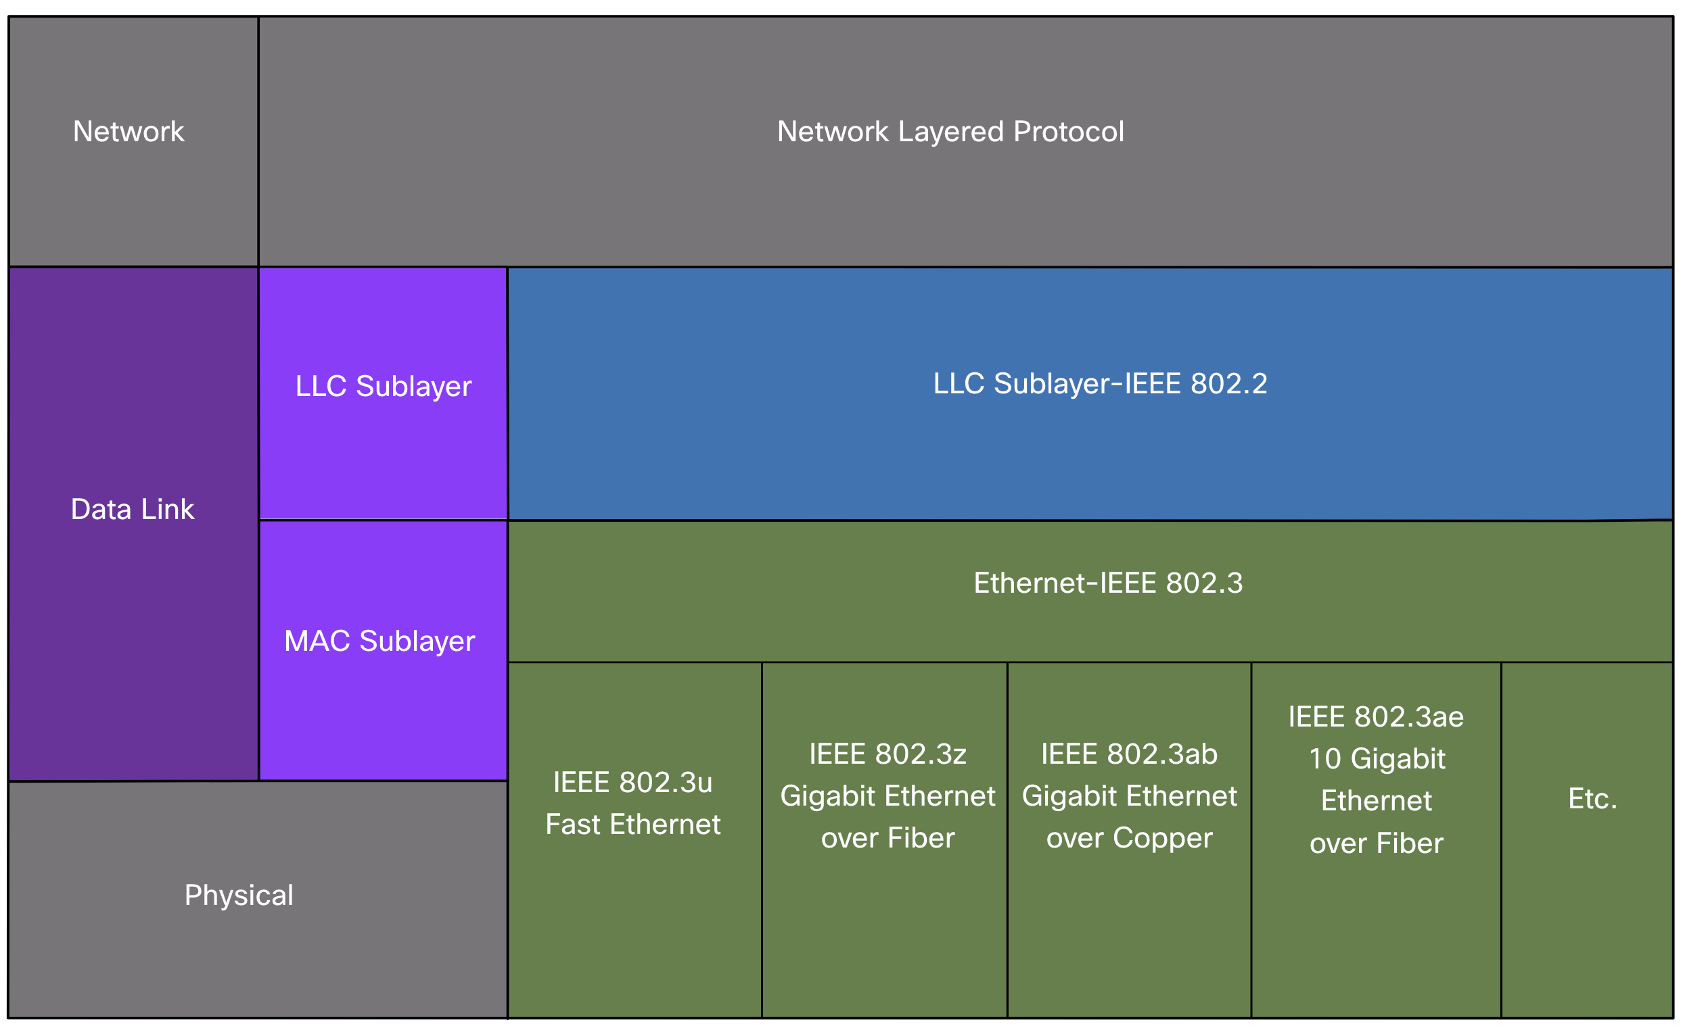
Ethernet Standards in the MAC Sublayer
Fig. 3 Ethernet Standards in the MAC Sublayer

Slide 11
Ethernet Standards in the MAC Sublayer
Ethernet using a bus topology or hubs, is a shared, half-duplex medium. Ethernet over a half-duplex medium uses a contention-based access method, carrier sense multiple access/collision detection (CSMA/CD) this ensures that only one device is transmitting at a time.
CSMA/CD allows multiple devices to share the same half-duplex medium, detecting a collision when more than one device attempts to transmit simultaneously.
It also provides a back-off algorithm for retransmission.
Ethernet LANs of today use switches that operate in full-duplex. Full-duplex communications with Ethernet switches do not require access control through CSMA/CD.

Slide 12
Ethernet Frame Fields
The minimum Ethernet frame size is 64 bytes and the expected maximum is 1518 bytes. This includes all bytes from the destination MAC address field through the frame check sequence (FCS) field.
The preamble field is not included when describing the size of the frame.
Note: The frame size may be larger if additional requirements are included, such as
VLAN tagging. VLAN tagging is beyond the scope of this course.

Slide 13
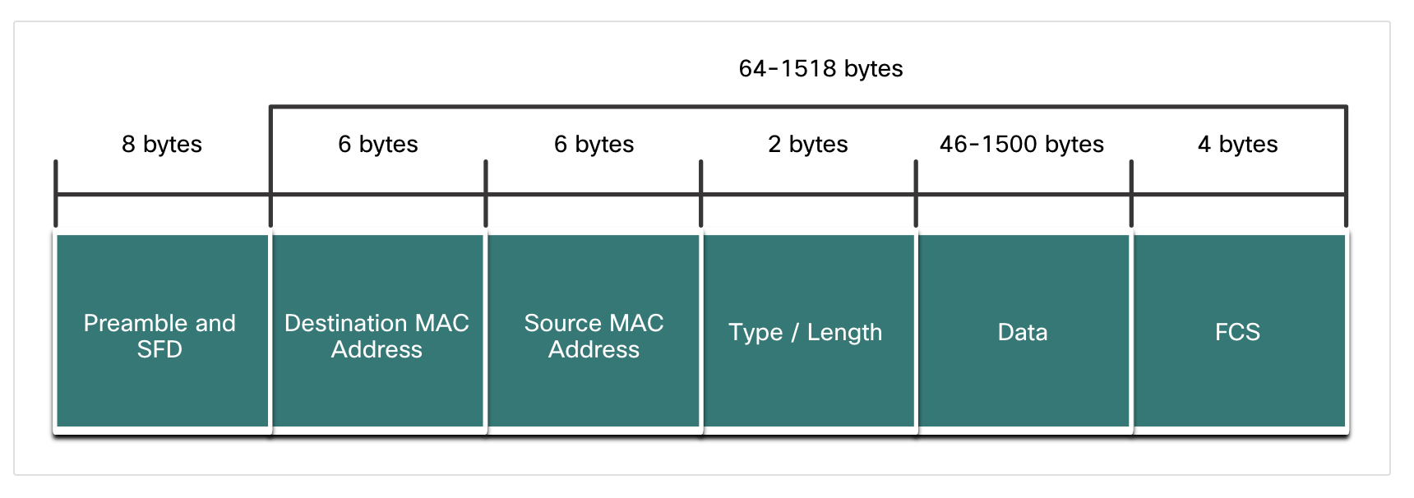
Ethernet Frame Fields
Any frame less than 64 bytes in length is considered a “collision fragment” or “runt frame” and is automatically discarded by receiving stations. Frames with more than 1500 bytes of data are considered “jumbo” or “baby giant frames”.
If the size of a transmitted frame is less than the minimum, or greater than the maximum, the receiving device drops the frame. Dropped frames are likely to be the result of collisions or other unwanted signals. They are considered invalid. Jumbo frames are usually supported by most Fast Ethernet and Gigabit Ethernet switches and NICs.
Fig. 4 Ethernet frame fields

Slide 14
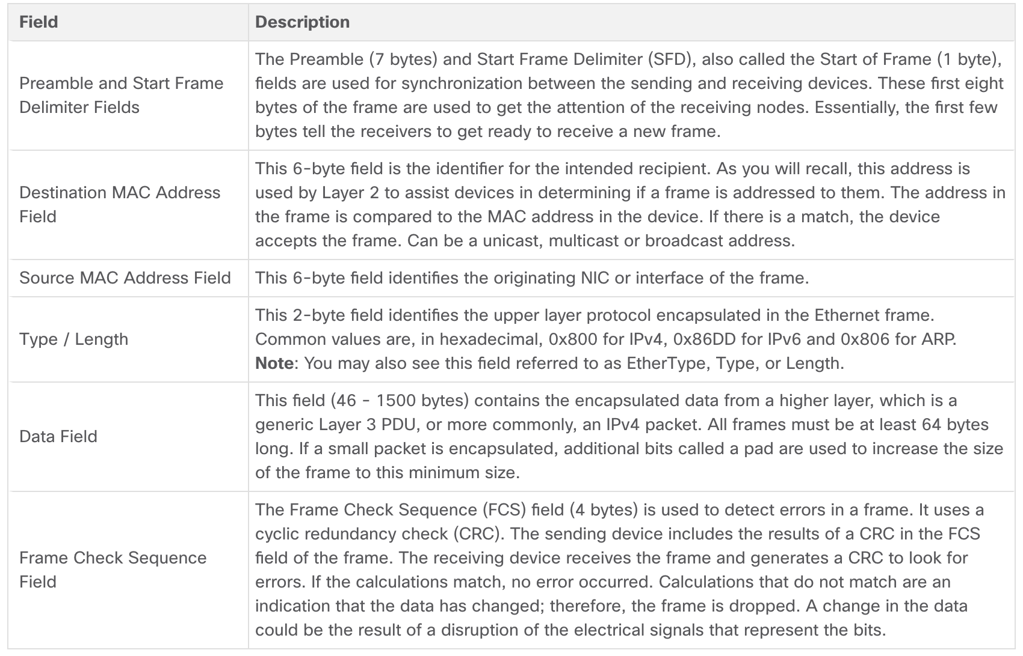
Ethernet Frame Fields Detail
Table 1 Ethernet Frame Fields Detail

Slide 15
Ethernet MAC Address
In networking, IPv4 addresses are represented using the decimal base ten number system and the binary base 2 number system.
IPv6 addresses and Ethernet addresses are represented using the hexadecimal base sixteen number system.
To understand hexadecimal, you must first be very familiar with binary and decimal.
The hexadecimal numbering system uses the numbers 0 to 9 and the letters A to F.
An Ethernet MAC address consists of a 48-bit binary value. Hexadecimal is used to identify an Ethernet address because a single hexadecimal digit represents four binary bits.
Therefore, a 48-bit Ethernet MAC address can be expressed using only 12 hexadecimal values.

Slide 16
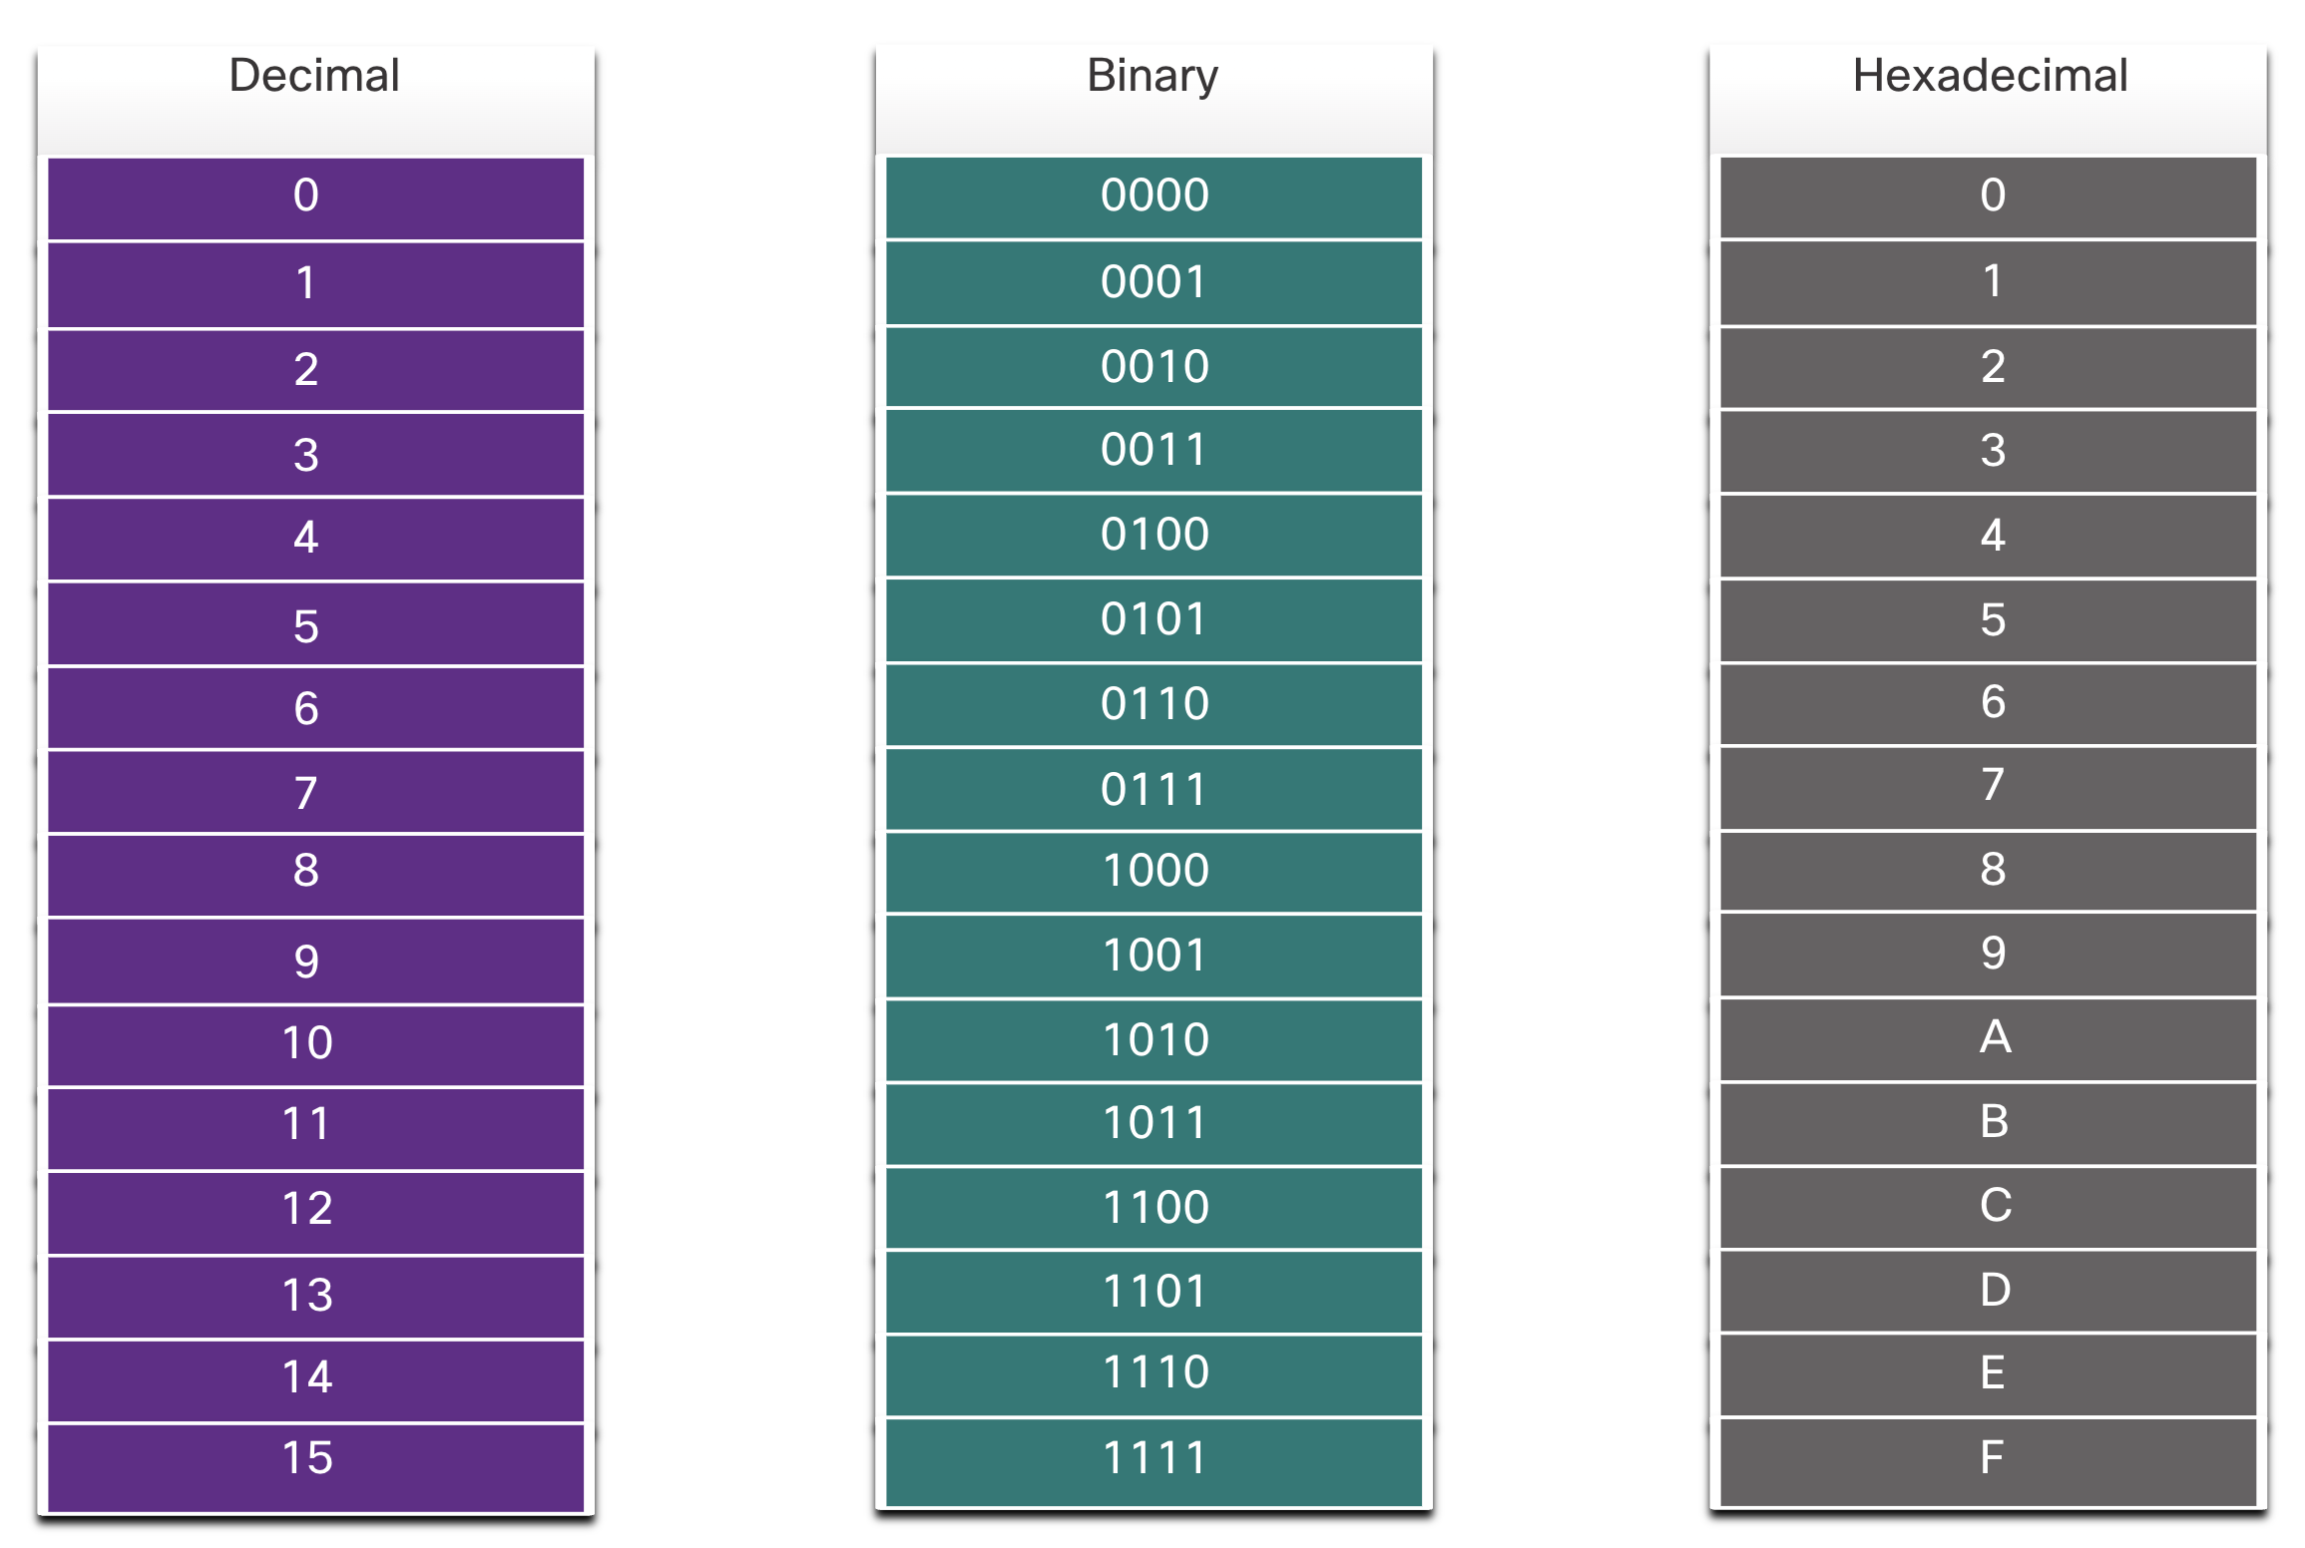
Decimal and Binary Equivalents of 0 to F Hexadecimal
Fig. 5 The figure compares the equivalent decimal and hexadecimal values for binary 0000 to 1111.

Slide 17
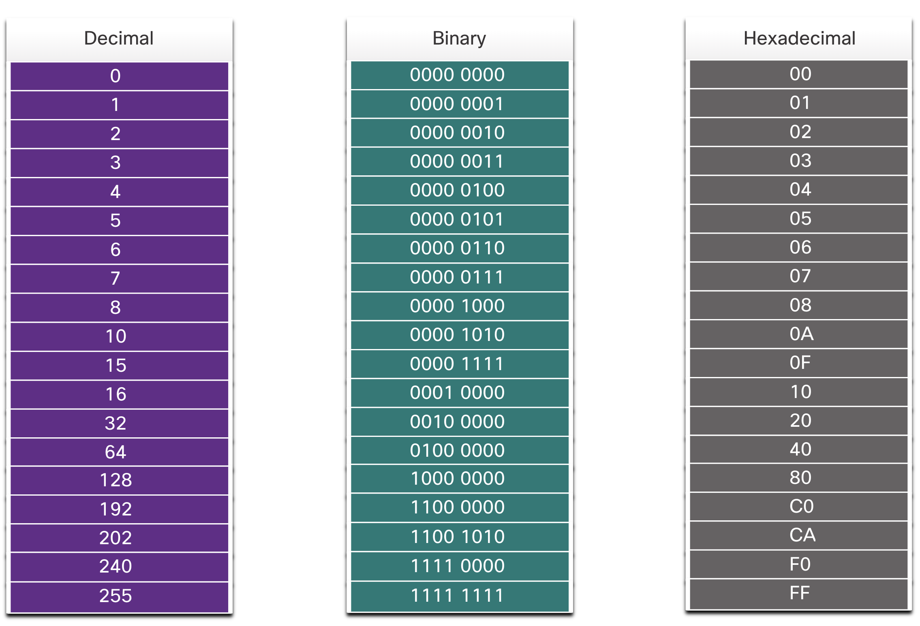
Decimal and Binary Equivalents of 0 to F Hexadecimal
Given that 8 bits (one byte) is a common binary grouping, binary 00000000 to 11111111 can be represented in hexadecimal as the range 00 to FF, as shown in the figure.
Fig. 6 Selected Decimal, Binary, and Hexadecimal Equivalents

Slide 18
Decimal and Binary Equivalents of 0 to F Hexadecimal
When using hexadecimal, leading zeroes are always displayed to complete the 8-bit representation.
For example, in the Fig. 6, the binary value 0000 1010 is shown in hexadecimal as 0A.
Hexadecimal numbers are often represented by the value preceded by 0x (e.g., 0x73) to distinguish between decimal and hexadecimal values in documentation.
Hexadecimal may also be represented by a subscript 16, or the hex number followed by an H (e.g., 73H).
You may have to convert between decimal and hexadecimal values.
If such conversions are required, convert the decimal or hexadecimal value to binary, and then to convert the binary value to either decimal or hexadecimal as appropriate.

Slide 19
Ethernet MAC Address
In an Ethernet LAN, every network device is connected to the same, shared media.
The MAC address is used to identify the physical source and destination devices (NICs) on the local network segment.
MAC addressing provides a method for device identification at the data link layer of the OSI model.
An Ethernet MAC address is a 48-bit address expressed using 12 hexadecimal digits, as shown in the figure. Because a byte equals 8 bits, we can also say that a MAC address is 6 bytes in length.

Slide 20
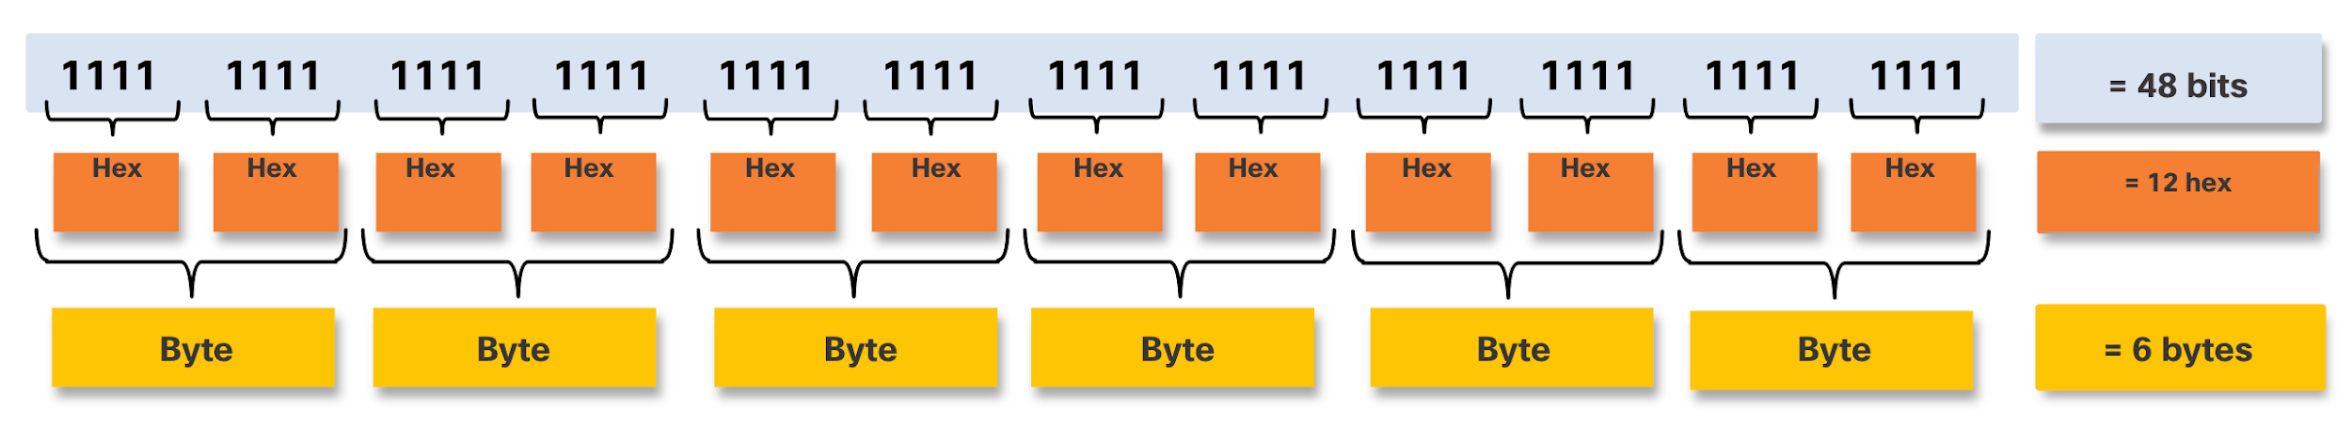
Ethernet MAC Address
Fig. 7 Ethernet MAC Address
All MAC addresses must be unique to the Ethernet device or Ethernet interface. To ensure this, all vendors that sell Ethernet devices must register with the IEEE to obtain a unique 6 hexadecimal (i.e., 24-bit or 3-byte) code called the organizationally unique identifier (OUI).

Slide 21
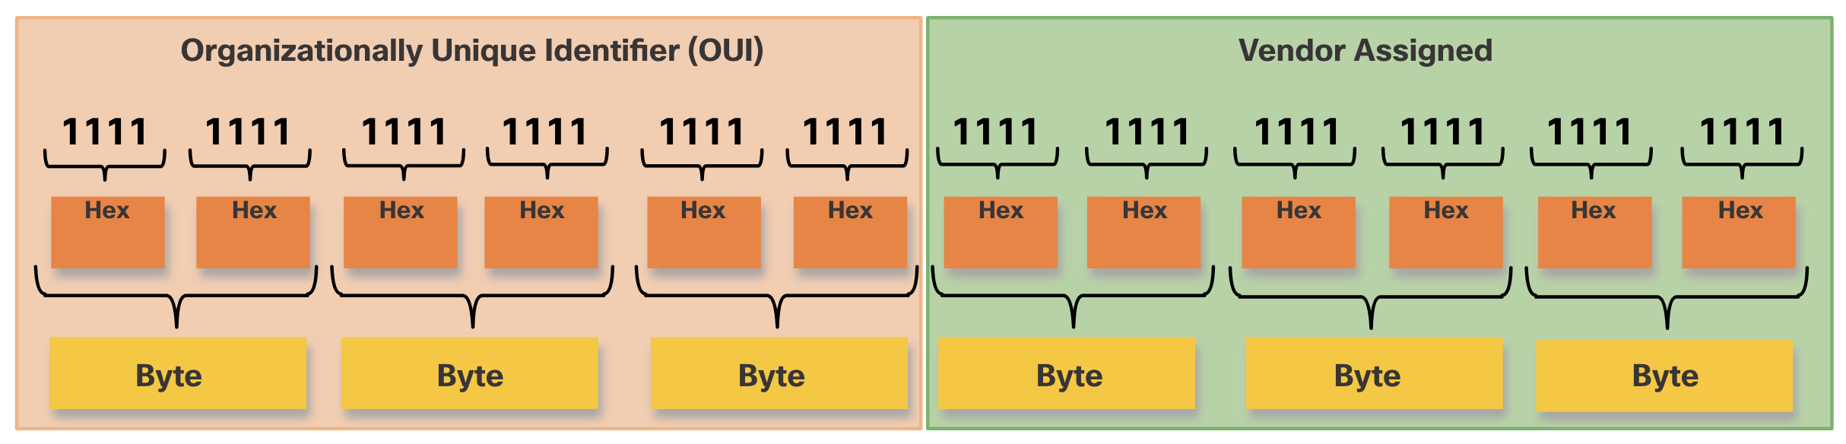
Ethernet MAC Address
When a vendor assigns a MAC address to a device or Ethernet interface, the vendor must do as follows:
Use its assigned OUI as the first 6 hexadecimal digits.
Assign a unique value in the last 6 hexadecimal digits.
Therefore, an Ethernet MAC address consists of a 6 hexadecimal vendor OUI code followed by a 6 hexadecimal vendor-assigned value, as shown in the figure.
Fig. 8 Ethernet MAC Address

Slide 22
Frame Processing
Sometimes the MAC address is referred to as a burned-in address (BIA) because the address is hard coded into read-only memory (ROM) on the NIC. This means that the address is encoded into the ROM chip permanently.
Note: On modern PC operating systems and NICs, it is possible to change the MAC address in software. This is useful when attempting to gain access to a network that filters based on BIA. Consequently, filtering or controlling traffic based on the MAC address is no longer as secure.
When the computer boots up, the NIC copies its MAC address from ROM into RAM.
When a device is forwarding a message to an Ethernet network, the Ethernet header includes these:
Source MAC address - This is the MAC address of the source device NIC.
Destination MAC address - This is the MAC address of the destination device NIC.

Slide 23
Frame Processing
When a NIC receives an Ethernet frame, it examines the destination MAC address to see if it matches the physical MAC address that is stored in RAM.
If there is no match, the device discards the frame. If there is a match, it passes the frame up the OSI layers, where the de-encapsulation process takes place.
Note: Ethernet NICs will also accept frames if the destination MAC address is a
broadcast or a multicast group of which the host is a member.
Any device that is the source or destination of an Ethernet frame, will have an Ethernet NIC and therefore, a MAC address. This includes workstations, servers, printers, mobile devices, and routers.

Slide 24
Q & A
An Ethernet frame consists of all of the following EXCEPT:
Destination MAC address
Source MAC address
IP address
Data payload
Answer: (c) IP address (IP addresses are found in higher layer protocols)
What is the maximum size of the data payload field in a standard Ethernet frame?
46 bytes
512 bytes
1500 bytes
Unlimited
Answer: (c) 1500 bytes

Slide 25
Q & A
Which layer of the OSI model does the Ethernet protocol operate at?
Physical Layer
Data Link Layer
Network Layer
Transport Layer
Answer: (b) Data Link Layer
Ethernet frames encapsulate data packets from which OSI layer protocol?
Physical Layer
Data Link Layer
Network Layer
Transport Layer
Answer: (c) Network Layer (Typically IP packets)

Slide 26
Q & A
How many bytes are there in a standard Ethernet destination MAC address field?
2 bytes
4 bytes
6 bytes
8 bytes
Answer: (c) 6 bytes
What is the function of the Preamble field in an Ethernet frame?
Synchronizes the receiver with the incoming data
Provides a unique identifier for the frame
Identifies the type of data encapsulated
Detects errors in the frame data
Answer: (a) Synchronizes the receiver with the incoming data

Slide 27
Q & A
How many bits are there in a standard Ethernet MAC address?
16 bits
32 bits
48 bits
64 bits
Answer: (c) 48 bits
When an Ethernet device receives a frame, it first checks:
The destination MAC address
The source MAC address
The data payload
The Frame Check Sequence (FCS)
Answer: (a) The destination MAC address

Slide 28
References
https://www.netacad.com/

